Slide 1
Pure ML Approaches for COVID-19 Peak Prediction

Slide 2
Motivation and Problem Statement
Covid-19 pandemic has led to the the entire world be in a state of turmoil and has significantly affected all walks of life.
Predicting the peak of cases is significant for any country to effectively fight against the disease and ensure minimal damage.
In this work, we try to determine the effectiveness of Machine Learning models to predict the peak for Covid-19 cases for India.

Slide 3
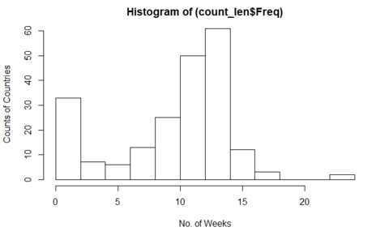
Details of the Dataset
We use the ‘Our World In Data’ dataset, which is a standardized collection of data from the ECDC.
The dataset provides daily Covid-19 data observed in countries across the world and other relevant details like population density, GDP per capita, Median age of the population.
Source: https://ourworldindata.org/coronavirus-source-data

Slide 4
Features in the Data Used
Sequential features in the data used - Total cases, New Cases, Total Cases per Million, New Cases per Million, Computed 7-Day Moving Averages of New Cases
Non-sequential features in the data used (Covariates)- Population, Population Density, GDP per Capita

Slide 5
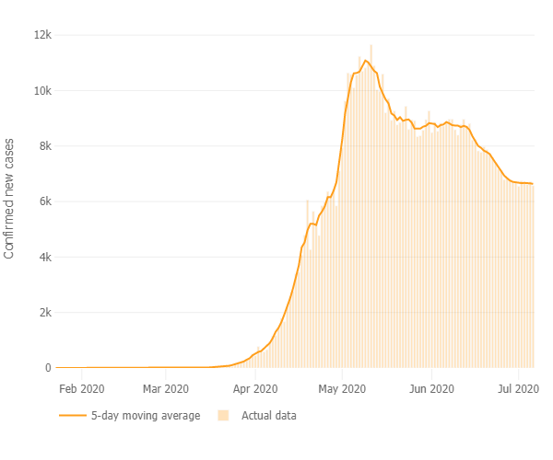
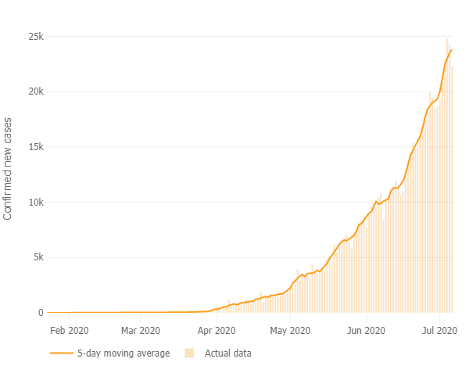
Defining a Peak
The week with the maximum number of new cases in a country.
New Cases Graph for Russia
New Cases Graph for India

Slide 6
Models Used
Linear Regression on week number in which the country peaks
Linear Regression to predict the curve for the rates of change of new cases
LSTM for regression on daily rates of change to predict peak of cases
LSTM for regression on day number on which the country peaks
LSTM based sequence classifier with new cases
LSTM based sequence classifier with rate of change

Slide 7
Linear regression on week number in which the country peaks
One model trained on the data of all the countries
X: 10 Features corresponding to the first 10 weekly values of new cases
Y: The week number from the start of the data when the country peaks
The results were not satisfactory as expected. Training RMSE turned out to be 3 weeks and Validation RMSE was more than 300.

Slide 8
Linear regression on rate of change to predict the week of peak
We try to predict the curve of the rates of change of new cases
X: Week number and its powers
Y: Rate of change of new cases for the corresponding week
We observe that the rates of change follow a logarithmic decrease
We obtain a good performance for most of the known countries but fail to perform well for India

Slide 9
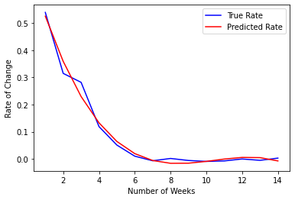
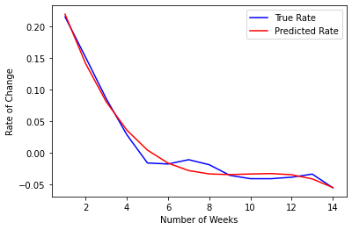
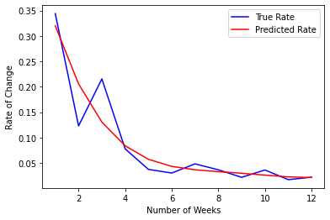
Linear regression on rate of change to predict the week of peak
U.S.A.
Italy
India

Slide 10
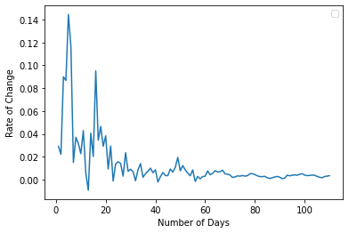
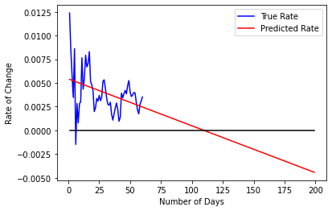
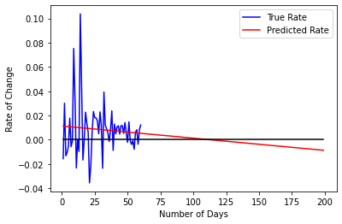
Linear regression on rate of change to predict the day of peak
India’s Rate of Change Curve
Prediction for India
Prediction for a country similar to India

Slide 11
LSTM for regression on future rates of change
The premise was to see if the past rates of change of new cases could be used to predict the future rates
X: Last 20 days’ rates of change of new cases
Y: Next 7 days’ rates of change of new cases
Covariates like population density and GDP per capita are concatenated as to the output of LSTM layer.
We fail to train the model correctly and believe that the recent past does not have enough information to make the predictions for the future.

Slide 12
LSTM for regression on day of peaking
We try to use the past rate of changes to predict how long will it take for the country to peak
X: Last 20 days’ rates of change of new cases
Y: Number of days from the current timestamp when the country peaks
Note- The split between training and validation set is made keeping in mind the cultural and economic factors for India.

Slide 13
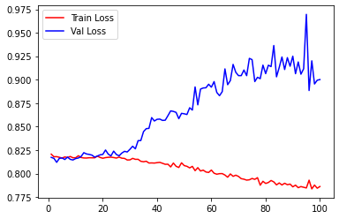
LSTM for regression on day of peaking
We observe that though training loss goes down, the validation loss doesn’t. A possible explanation is that the training and validation set differ too much from each other

Slide 14
LSTM Based Sequence Classifiers
Models to predict if the week after n weeks from now is the week where the covid new cases will be max for a country, i.e. it’ll peak
Further, we find the peak of each country and take the last (x+1)*7 to 7 days previous to peak as sequential features for the LSTM model with the following six features:
Total_cases,New_cases,Total_cases_per_million,New_cases_per_million
moving_average(new_cases),moving_average(new_cases_per_million)
So as to form,
X :n_countries*(x+1)7*6 features for training
Y : 0, 1 classification
On some models we only take rate of change of moving_average(new_cases) & moving_average(new_cases_per_million)

Slide 15
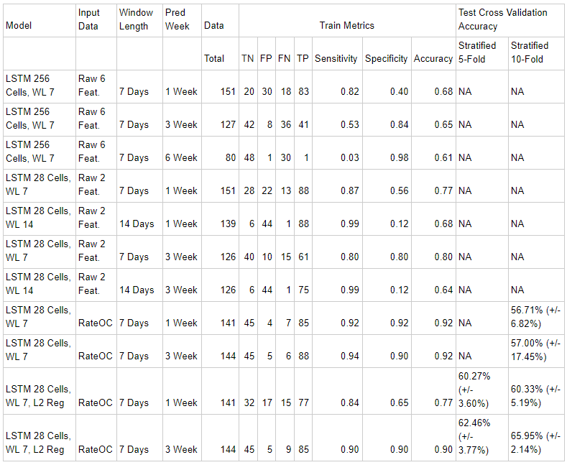
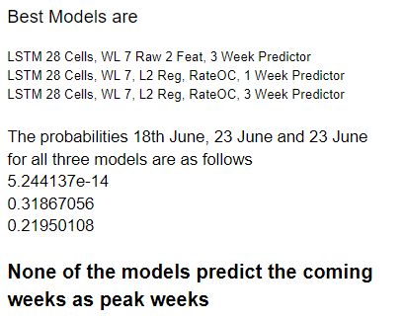
Results (LSTM Based Sequence Classifiers)

Slide 16
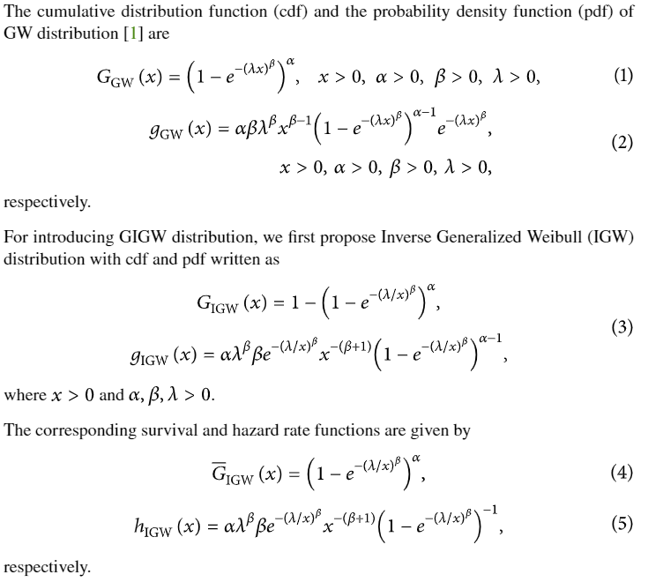
Weibull Distribution Curve (Simple Non-ML Ap.)
While machine learning and linear fit like linear regression may not give a good fit for coronavirus cases, we could make mathematical inferences/assumptions from observed data.
The one thing observed among countries that have peaked is the best mathematical distribution fitting for coronavirus is Generalized Weibull Distribution, which is given by as follows:-

Slide 17
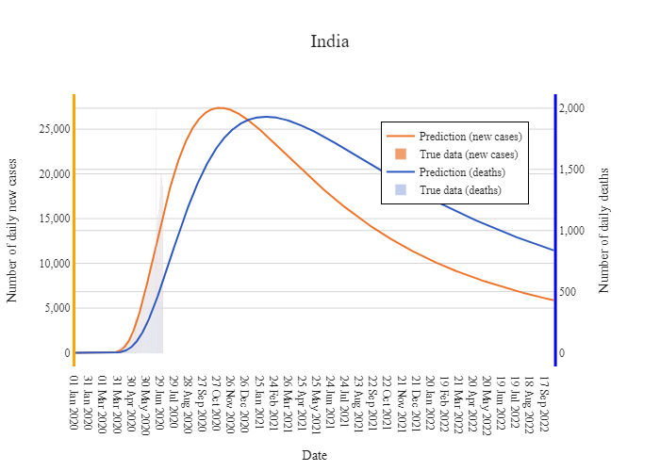
Results (Weibull Distribution Curve)
This is however prone would best work assuming that lockdown had limited and minimal effects on the curve which is not the case.
But assuming the same the peak would occur in the first week of November

Slide 18
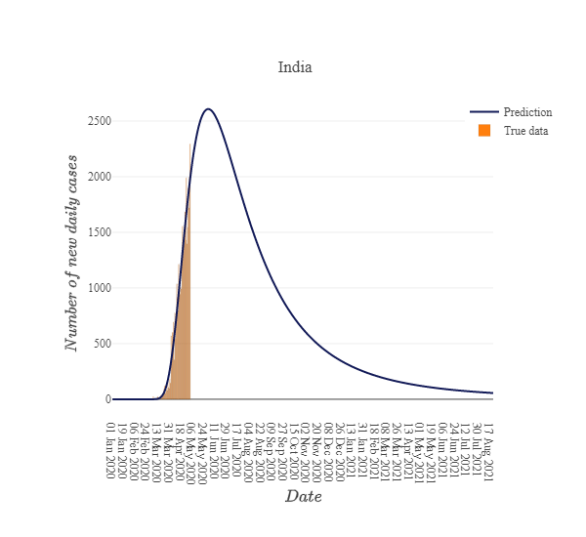
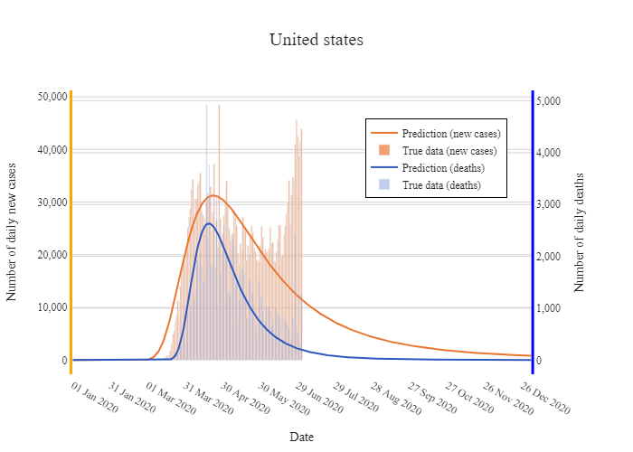
The same model with data till May 2 (vs the on above I ran on 3 July predicting November Week 1) had predicted the peak to happen around June 2.
Which might even have happened is a continuous lockdown was maintained. It also does not work if we assume an uneven distribution/multiple waves.

Slide 19
Further possibilities / Questions
Compartmental ML Models
Statistical inference based models, a Weibull curve based LSTM regression.
Other possible ways to improve test accuracy in LSTM classifiers
Models like ARMA, ARIMA and ARIMAX to see if higher orders of difference gives us stationarity

Slide 20
Questions We Have
Does the Linear Regression approach for the prediction of the curve of the rates seem viable? The input to the model is simple, however, the predictions seem to be somewhat correct.
Do you have any suggestions to improve the training of the LSTM approach of predicting the day of peaking?
Could we incorporate the covariates more effectively to lay emphasis on features that are of significance for the problem?

Slide 21
Fin

